Slide 1
Domain ML
Technology: Python
A COMPARATIVE STUDY OF MACHINE LEARNING AND DEEP LEARNING
TECHNIQUES FOR FAKE REVIEW DETECTION

Slide 2
ABSTRACT
With the continual evolution , online evaluations are increasingly seen as a critical aspect in establishing and keeping a positive reputation. Furthermore, they play an important part in the decision-making process for end consumers. A good review for a specific object typically draws more consumers and leads to a significant rise in sales. Deceptive or phoney evaluations are now purposefully generated in order to develop a virtual reputation and attract potential clients. As a result, detecting false reviews is an active and ongoing research topic. Identifying phoney reviews is dependent not only on the essential elements of the reviews, but also on the reviewers' behaviour. This research provides a machine learning method for detecting false reviews. In addition to the review features extraction approach, this research employs different features engineering techniques to extract diverse reviewer behaviours. The study examines the performance of machine learning classifiers; Decision Tree, Random Forest, SVC, CNN, Naïve Bias, Logistic Regression, XGBoost, ANN, LSTM, BERT. The results demonstrate that the algorithm is better at determining whether a review is bad or genuine.

Slide 3
INTRODUCTION
Nowadays, when customers want to draw a decision about services or products, reviews become the main source of their information. For example, when customers take the initiation to book a hotel, they read the reviews on the opinions of other customers on the hotel services. Depending on the feedback of the reviews, they decide to book room or not. If they came to a positive feedback from the reviews, they probably proceed to book the room. Thus, historical reviews became very credible sources of information to most people in several online services. Since, reviews are considered forms of sharing authentic feedback about positive or negative services, any attempt to manipulate those reviews by writing misleading or inauthentic content is considered as deceptive action and such reviews are labelled as fake Such case leads us to think what if not all the written reviews are honest or credible. What if some of these reviews are fake. Thus, detecting fake review has become and still in the state of active and required research area. The rise of social media has blurred the line between authentic content and advertising, leading to an explosion in deceptive endorsements across the marketplace. Fake online reviews and other deceptive endorsements often tout products throughout the online world. Consequently, the FTC is now using its Penalty Offense Authority to remind advertisers of the law and deter them from breaking it. By sending a Notice of Penalty Offenses to more than 700 companies,

Slide 4
the agency is placing them on notice they could incur significant civil penalties—up to $43,792 per violation—if they use endorsements in ways that run counter to prior FTC administrative cases. “Fake reviews and other forms of deceptive endorsements cheat consumers and undercut honest businesses,” said Samuel Levine, Director of the FTC’s Bureau of Consumer Protection. “Advertisers will pay a price if they engage in these deceptive practices.”
The Notice of Penalty Offenses allows the agency to seek civil penalties against a company that engages in conduct that it knows has been found unlawful in a previous FTC administrative order, other than a consent order.
The Notice sent to the companies outlines a number of practices that the FTC determined to be unfair or deceptive in prior administrative cases. These include, but are not limited to: falsely claiming an endorsement by a third party; misrepresenting whether an endorser is an actual, current, or recent user; using an endorsement to make deceptive performance claims; failing to disclose an unexpected material connection with an endorser; and misrepresenting that the experience of endorsers represents consumers’ typical or ordinary experience.
Companies receiving the notice represent an array of large companies, top advertisers, leading retailers, top consumer product companies, and major advertising agencies. A full list of the businesses receiving the Notice from the FTC is available on the FTC’s website. A recipient’s presence on this list does not in any way suggest that it has engaged in deceptive or unfair conduct.

Slide 5
In addition to the Notice, the FTC has created multiple resources for business to ensure that they are following the law when using endorsements to advertise their products and services, which can be found on the FTC’s website.
To this end, this paper applies several machine learning classifiers to identify fake reviews based on the content of the reviews as well as several extracted features from the reviewers. We apply the classifiers on real corpus of reviews taken from open source sites. Besides the normal natural language processing on the corpus to extract and feed the features of the reviews to the classifiers, the paper also applies several features engineering on the corpus to extract various behaviours of the reviewers. The paper compares the impact of extracted features of the reviewers if they are taken into consideration within the classifiers. The papers compares the results in the absence and the presence of the extracted features in two different language models namely TF-IDF. The results indicates that the engineered features increase the performance of fake reviews detection process.The rapid growth of the Internet influenced many of our daily activities. One of the very rapid growth area is
ecommerce. Generally e-commerce provide facility for customers to write reviews related with its service. The existence of these reviews can be used as a source of information. For examples,

Slide 6
companies can use it to make design decisions of their products or services, while potential customers can use it to decide either to buy or to use a product. Unfortunately, the importance of the review is misused by certain parties who tried to create fake reviews, both aimed at raising the popularity or to discredit the product. This research aims to detect fake reviews for a product by using the text and rating property from a review.The rapid growth of the Internet influenced many of our daily activities. One of the very rapid growth area is ecommerce. Generally e-commerce provide facility for customers to write reviews related with its service. The existence of these reviews can be used as a source of information. For examples,companies can use it to make design decisions of their products or services, while potential customers can use it to decide either to buy or to use a product. Unfortunately, the importance of the review is misused by certain parties who tried to create fake reviews, both aimed at raising the popularity or to discredit the product. This research aims to detect fake reviews for a product by using the text and rating property from a review.The rapid growth of the Internet influenced many of our daily activities. One of the very rapid growth area is ecommerce. Generally e-commerce provide facility for customers to write reviews related with its service. The existence of these reviews can be used as a source of information. For examples,

Slide 7
companies can use it to make design decisions of their products or services, while potential customers can use it to decide either to buy or to use a product. Unfortunately, the importance of the review is misused by certain parties who tried to create fake reviews, both aimed at raising the popularity or to discredit the product. This research aims to detect fake reviews for a product by using the text and rating property from a review. Machine learning techniques can provide a big contribution to detect fake reviews of web contents. Generally, web mining techniques find and extract useful information using several machine learning algorithms. One of the web mining tasks is content mining. A traditional example of content mining is opinion mining which is concerned of finding the sentiment of text (positive or negative) by machine learning where a classifier is trained to analyse the features of the reviews together with the sentiments. Usually, fake reviews detection depends not only on the category of reviews but also on certain features that are not directly connected to the content. Building features of reviews normally involves text and natural language processing NLP. However, fake reviews may require building other features linked to the reviewer himself like for example review time/date or his writing styles. Thus the successful fake reviews detection lies on the construction of meaningful features extraction of the reviewers.

Slide 8
Usually, fake reviews detection depends not only on the category of reviews but also on certain features that are not directly connected to the content. Building features of reviews normally involves text and natural language processing NLP. However, fake reviews may require building other features linked to the reviewer himself like for example review time/date or his writing styles. Thus the successful fake reviews detection lies on the construction of meaningful features extraction of the reviewers

Slide 9
LITERATURE SURVEY
Author and years | Tittle | Proposed | Outcomes
RAMI MOHAWESH 1 , SHUXIANG XU | Fake Reviews Detection: A Survey | In e-commerce, user reviews can play a significant role in determining the revenue of an organisation. Online users rely on reviews before making decisions about any product and service. As such, the credibility of online reviews is crucial for businesses and can directly affect companies’ reputation and profitability. That is why some businesses are paying spammers to post fake reviews. | These fake reviews exploit consumer purchasing decisions. Consequently
Emerson F. Cardoso, Renato M. Silva, Tiago A. Almeida∗ | Towards automatic filtering of fake reviews | Online opinions significantly influence consumer purchase decisions. Unfortunately, this has led to a dramatic increase of fake (or spam) reviews that can damage the reputation of brands and artificially manipulate users’ perceptions about products and companies | fake review detection, important questions still remain open. For instance,

Slide 10
Author and years | Tittle | Proposed | Outcomes
Yafeng Ren and Yue Zhang | Deceptive Opinion Spam Detection Using Neural Network | Deceptive opinion spam detection has attracted significant attention from both business and research communities. Existing approaches are based on manual discrete features, which can capture linguistic and psychological cues. . | such features fail to encode the semantic meaning of a document from the discourse perspective
Arjun Mukherjee† , Vivek Venkataraman† , Bing Liu† , Natalie Glance‡ | Fake Review Detection: Classification and Analysis of Real and Pseudo Reviews | In recent years, fake review detection has attracted significant attention from both businesses and the research community. For reviews to reflect genuine user experiences and opinions, detecting fake reviews is an important problem. | Supervised learning has been one of the main approaches for solving the problem..

Slide 11
EXISTING SYSTEM
The increasing growth of machine learning, computer techniques divided into traditional methods and machine learning methods. This section describes the related works of classification of A Comparative Study Of Machine Learning And Deep Learning Techniques For Fake review Detection and how machine learning methods are better than traditional methods. The existing method in this project have a certain flow is used for model development CNN are used algorithms in existing system. But it requires large memory and result is not accurate.
Disadvantages:
High complexity.
Time consuming.

Slide 12
PROPOSED SYSTEM
Proposed several machine learning models model to classify but none have adequately addressed this misdiagnosis problem. That can be used for this purpose are Integrating Machine Learning Algorithms with A Comparative Study Of Machine Learning And Deep Learning Techniques For Fake review Detection . Also, similar studies that have proposed models for evaluation of such tumors mostly do not consider the heterogeneity and the size of the data Therefore, we propose a machine learning-based approach which combines a new technique of preprocessing the data for features transformation, Logistic Regression, Support Vector Machine , Random forest , Naive Bayes , Decision Tree and XGBoost as machine learning LSTM, Bi-LSTM and BERT give the best accuracy techniques to eliminate the bias and the deviation of instability and performing classifier tests based.
Advantages:
Highest accuracy
Reduces time complexity.
Easy to use

Slide 13
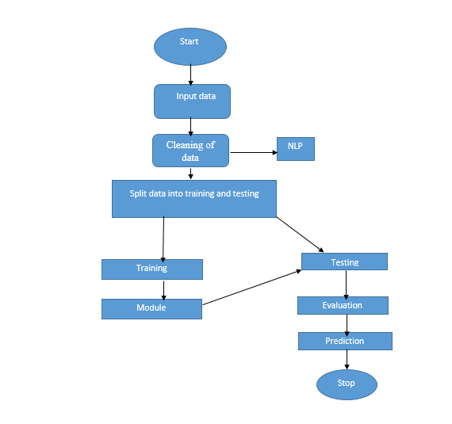
PROPOSED METHOD

Slide 14
ALGORITHMS
1. Random Forest:
A random forest is a machine learning technique that’s used to solve regression and classification problems. It utilizes ensemble learning, which is a technique that combines many classifiers to provide solutions to complex problems.
A random forest algorithm consists of many decision trees. The ‘forest’ generated by the random forest algorithm is trained through bagging or bootstrap aggregating. Bagging is an ensemble meta-algorithm that improves the accuracy of machine learning algorithms.
The (random forest) algorithm establishes the outcome based on the predictions of the decision trees. It predicts by taking the average or mean of the output from various trees. Increasing the number of trees increases the precision of the outcome.
A random forest eradicates the limitations of a decision tree algorithm. It reduces the over fitting of datasets and increases precision. It generates predictions without requiring many configurations in packages (like Scikit-learn).

Slide 15
Features of a Random Forest Algorithm:
• It’s more accurate than the decision tree algorithm.
• It provides an effective way of handling missing data.
• It can produce a reasonable prediction without hyper-parameter tuning.
• It solves the issue of over fitting in decision trees.
• In every random forest tree, a subset of features is selected randomly at the node’s splitting point.
Decision trees are the building blocks of a random forest algorithm. A decision tree is a decision support technique that forms a tree-like structure. An overview of decision trees will help us understand how random forest algorithms work.
A decision tree consists of three components: decision nodes, leaf nodes, and a root node. A decision tree algorithm divides a training dataset into branches, which further segregate into other branches. This sequence continues until a leaf node is attained. The leaf node cannot be segregated further.

Slide 16
2. Neural Networks:
An artificial neural network (ANN) is the piece of a computing system designed to simulate the way the human brain analyses and processes information. It is the foundation of artificial intelligence (AI) and solves problems that would prove impossible or difficult by human or statistical standards. ANNs have self-learning capabilities that enable them to produce better results as more data becomes available.
An ANN has hundreds or thousands of artificial neurons called processing units, which are interconnected by nodes. These processing units are made up of input and output units. The input units receive various forms and structures of information based on an internal weighting system, and the neural network attempts to learn about the information presented to produce one output report. Just like humans need rules and guidelines to come up with a result or output, ANNs also use a set of learning rules called back propagation, an abbreviation for backward propagation of error, to perfect their output results. An ANN initially goes through a training phase where it learns to recognize patterns in data, whether visually, aurally, or textually. During this supervised phase, the network compares its actual output produced with what it was meant to produce—the desired output. The difference between both outcomes is adjusted using back propagation.

Slide 17

3. Support Vector Machine:
Support Vector Machine or SVM is one of the most popular Supervised Learning algorithms, which is used for Classification as well as Regression problems. However, primarily, it is used for Classification problems in Machine Learning. The goal of the SVM algorithm is to create the best line or decision boundary that can segregate n-dimensional space into classes so that we can easily put the new data point in the correct category in the future. This best decision boundary is called a hyperplane. SVM chooses the extreme points/vectors that help in creating the hyperplane. These extreme cases are called as support vectors, and hence algorithm is termed as Support Vector Machine. Consider the below diagram in which there are two different categories that are classified using a decision boundary or hyperplane:

Slide 18
SVM can be of two types:
Linear SVM: Linear SVM is used for linearly separable data, which means if a dataset can be classified into two classes by using a single straight line, then such data is termed as linearly separable data, and classifier is used called as Linear SVM classifier.
Non-linear SVM: Non-Linear SVM is used for non-linearly separated data, which means if a dataset cannot be classified by using a straight line, then such data is termed as non-linear data and classifier used is called as Non-linear SVM classifier.
Hyperplane and Support Vectors in the SVM algorithm:
Hyperplane:
There can be multiple lines/decision boundaries to segregate the classes in n-dimensional space, but we need to find out the best decision boundary that helps to classify the data points. This best boundary is known as the hyperplane of SVM.
The dimensions of the hyperplane depend on the features present in the dataset, which means if there are 2 features (as shown in image), then hyperplane will be a straight line. And if there are 3 features, then hyperplane will be a 2-dimension plane.

Slide 19
The dimensions of the hyperplane depend on the features present in the dataset, which means if there are 2 features (as shown in image), then hyperplane will be a straight line. And if there are 3 features, then hyperplane will be a 2-dimension plane.
We always create a hyperplane that has a maximum margin, which means the maximum distance between the data points.
Support Vectors:
The data points or vectors that are the closest to the hyperplane and which affect the position of the hyperplane are termed as Support Vector. Since these vectors support the hyperplane, hence called a Support vector

Slide 20
4. LOGISTIC REGRESSION
Logistic Regression was used in the biological sciences in early twentieth century. It was then used in many social science applications. Logistic Regression is used when the dependent variable (target) is categorical.
For example,
To predict whether an email is spam (1) or (0)
Whether the tumor is malignant (1) or not (0)
Consider a scenario where we need to classify whether an email is spam or not. If we use linear regression for this problem, there is a need for setting up a threshold based on which classification can be done. Say if the actual class is malignant, predicted continuous value 0.4 and the threshold value is 0.5, the data point will be classified as not malignant which can lead to serious consequence in real time.
From this example, it can be inferred that linear regression is not suitable for classification problem. Linear regression is unbounded, and this brings logistic regression into picture. Their value strictly ranges from 0 to 1.

Slide 21
5.Decision Tree
A tree has many analogies in real life, and turns out that it has influenced a wide area of machine learning, covering both classification and regression. In decision analysis, a decision tree can be used to visually and explicitly represent decisions and decision making. As the name goes, it uses a tree-like model of decisions. Though a commonly used tool in data mining for deriving a strategy to reach a particular goal.
A decision tree is drawn upside down with its root at the top. In the image on the left, the bold text in black represents a condition/internal node, based on which the tree splits into branches/ edges. The end of the branch that doesn’t split anymore is the decision/leaf, in this case, whether the passenger died or survived, represented as red and green text respectively.
Although, a real dataset will have a lot more features and this will just be a branch in a much bigger tree, but you can’t ignore the simplicity of this algorithm. The feature importance is clear and relations can be viewed easily. This methodology is more commonly known as learning decision tree from data and above tree is called Classification tree as the target is to classify passenger as survived or died. Regression trees are represented in the same manner, just they predict continuous values like price of a house. In general, Decision Tree algorithms are referred to as CART or Classification and Regression Trees.

Slide 22
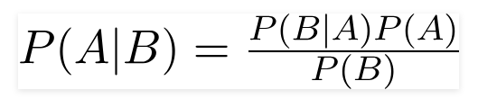
6.NAIVE BAYES:
A Naive Bayes classifier is a probabilistic machine learning model that’s used for classification task. The crux of the classifier is based on the Bayes theorem.
Using Bayes theorem, we can find the probability of A happening, given that B has occurred. Here, B is the evidence and A is the hypothesis. The assumption made here is that the predictors/features are independent. That is presence of one particular feature does not affect the other. Hence it is called naive.
Let’s understand it using an example. Below I have a training data set of weather and corresponding target variable ‘Play’ (suggesting possibilities of playing). Now, we need to classify whether players will play or not based on weather condition. Let’s follow the below steps to perform it.
Step 1: Convert the data set into a frequency table
Step 2: Create Likelihood table by finding the probabilities like Overcast probability = 0.29 and probability of playing is 0.64.

Slide 23
7. XGBoost
XGBoost stands for “Extreme Gradient Boosting”. XGBoost is an optimized distributed gradient boosting library designed to be highly efficient, flexible and portable. It implements Machine Learning algorithms under the Gradient Boosting framework. It provides a parallel tree boosting to solve many data science problems in a fast and accurate way.
Boosting
Boosting is an ensemble learning technique to build a strong classifier from several weak classifiers in series. Boosting algorithms play a crucial role in dealing with bias-variance trade-off. Unlike bagging algorithms, which only controls for high variance in a model, boosting controls both the aspects (bias & variance) and is considered to be more effective.
Below are the few types of boosting algorithms:
AdaBoost (Adaptive Boosting)
Gradient Boosting
XGBoost
CatBoost
Light GBM

Slide 24
8.LSTM:
Why Recurrent Neural Networks?
Recurrent neural networks were created because there were a few issues in the feed-forward neural network:
Cannot handle sequential data
Considers only the current input
Cannot memorize previous inputs
The solution to these issues is the Recurrent Neural Network (RNN). An RNN can handle sequential data, accepting the current input data, and previously received inputs. RNNs can memorize previous inputs due to their internal memory.
It is a variety of recurrent neural networks (RNNs) that are capable of learning long-term dependencies, especially in sequence prediction problems. LSTM has feedback connections, i.e., it is capable of processing the entire sequence of data, apart from single data points such as images.
The central role of an LSTM model is held by a memory cell known as a ‘cell state’ that maintains its state over time. The cell state is the horizontal line that runs through the top of the below diagram. It can be visualized as a conveyor belt through which information just flows, unchanged.

Slide 25
9. CNN(Convolutional neural Network):
Convolutional Neural Networks were developed as a result of the fact that only some individual neuronal cells in the brain fire when certain orientation edges are present. For example, some neurons respond when exposed to vertical edges, while others respond when exposed to horizontal or diagonal edges.
Convolutional neural networks, sometimes referred to as covnets, are neural networks with shared parameters, to put it simply. Think of a cuboid-shaped picture with the following measurements: length, width, and height. The Red, Green, and Blue channels here provide as an example of the size of the picture,

Slide 26
10. BERT:
BERT is an open-source library created in 2018 at Google. It's a new technique for NLP and it takes a completely different approach to training models than any other technique.
BERT is an acronym for Bidirectional Encoder Representations from Transformers. That means unlike most techniques that analyze sentences from left-to-right or right-to-left, BERT goes both directions using the Transformer encoder. Its goal is to generate a language model.
This gives it incredible accuracy and performance on smaller data sets which solves a huge problem in natural language processing.
While there is a huge amount of text-based data available, very little of it has been labeled to use for training a machine learning model. Since most of the approaches to NLP problems take advantage of deep learning, you need large amounts of data to train with.
You really see the huge improvements in a model when it has been trained with millions of data points. To help get around this problem of not having enough labelled data, researchers came up with ways to train general purpose language representation models through pre-training using text from around the internet.

Slide 27
UML DIAGRAMS
UML stands for Unified Modelling Language. UML is a standardized general-purpose modelling language in the field of object-oriented software engineering. The standard is managed, and was created by, the Object Management Group. The goal is for UML to become a common language for creating models of object-oriented computer software. In its current form UML is comprised of two major components: a Meta-model and a notation. In the future, some form of method or process may also be added to; or associated with, UML.
The Unified Modelling Language is a standard language for specifying, Visualization, Constructing and documenting the artifacts of software system, as well as for business modelling and other non-software systems.
The UML represents a collection of best engineering practices that have proven successful in the modelling of large and complex systems.
The UML is a very important part of developing objects-oriented software and the software development process. The UML uses mostly graphical notations to express the design of software projects

Slide 28
GOALS:
The Primary goals in the design of the UML are as follows:
Provide users a ready-to-use, expressive visual modelling Language so that they can develop and exchange meaningful models.
Provide extendibility and specialization mechanisms to extend the core concepts.
Be independent of particular programming languages and development process.
Provide a formal basis for understanding the modelling language.
Encourage the growth of OO tools market.
Support higher level development concepts such as collaborations, frameworks, patterns and components.
Integrate best practices.

Slide 29
Use case diagram:
A use case diagram in the unified modeling language (uml) is a type of behavioral diagram defined by and created from a use-case analysis. Its purpose is to present a graphical overview of the functionality provided by a system in terms of actors, their goals (represented as use cases), and any dependencies between those use cases. The main purpose of a use case diagram is to show what system functions are performed for which actor. Roles of the actors in the system can be depicted.

Slide 30
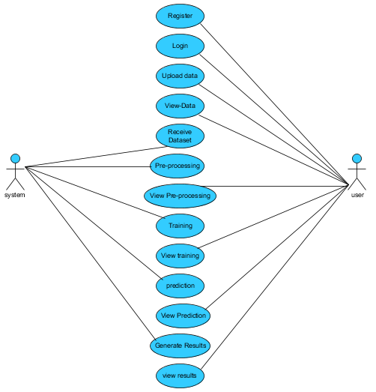

Slide 31
Class diagram:
In software engineering, a class diagram in the unified modeling language (uml) is a type of static structure diagram that describes the structure of a system by showing the system's classes, their attributes, operations (or methods), and the relationships among the classes. It explains which class contains information.

Slide 32
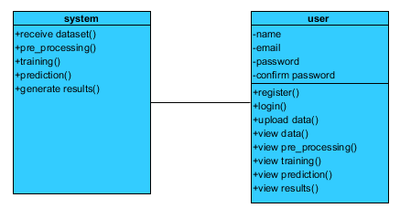

Slide 33
Sequence diagram:
A sequence diagram in unified modeling language (uml) is a kind of interaction diagram that shows how processes operate with one another and in what order. It is a construct of a message sequence chart. Sequence diagrams are sometimes called event diagrams, event scenarios, and timing diagrams.

Slide 34
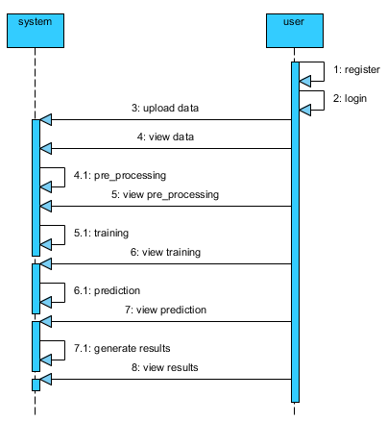

Slide 35
Collaboration diagram:
In collaboration diagram the method call sequence is indicated by some numbering technique as shown below. The number indicates how the methods are called one after another. We have taken the same order management system to describe the collaboration diagram. The method calls are similar to that of a sequence diagram. But the difference is that the sequence diagram does not describe the object organization whereas the collaboration diagram shows the object organization.

Slide 36
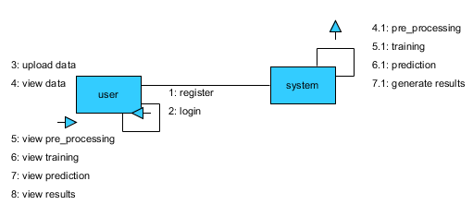

Slide 37
Deployment diagram:
Deployment diagram represents the deployment view of a system. It is related to the component diagram. Because the components are deployed using the deployment diagrams. A deployment diagram consists of nodes. Nodes are nothing but physical hard ware’s used to deploy the application.

Slide 38


Slide 39
Component diagram:
Component diagrams are used to describe the physical artifacts of a system. This artifact includes files, executable, libraries etc. So the purpose of this diagram is different, component diagrams are used during the implementation phase of an application. But it is prepared well in advance to visualize the implementation details. Initially the system is designed using different uml diagrams and then when the artifacts are ready component diagrams are used to get an idea of the implementation.

Slide 40
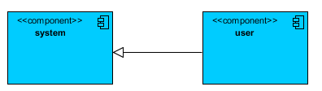

Slide 41
Activity diagram:
Activity diagrams are graphical representations of workflows of stepwise activities and actions with support for choice, iteration and concurrency. In the unified modeling language, activity diagrams can be used to describe the business and operational step-by-step workflows of components in a system. An activity diagram shows the overall flow of control.

Slide 42
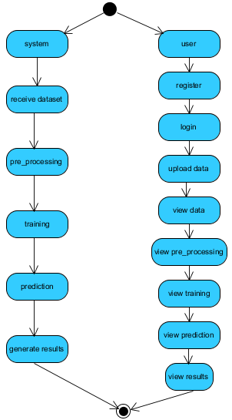

Slide 43
ER Diagram:
An Entity–relationship model (ER model) describes the structure of a database with the help of a diagram, which is known as Entity Relationship Diagram (ER Diagram). An ER model is a design or blueprint of a database that can later be implemented as a database. The main components of E-R model are: entity set and relationship set.

Slide 44
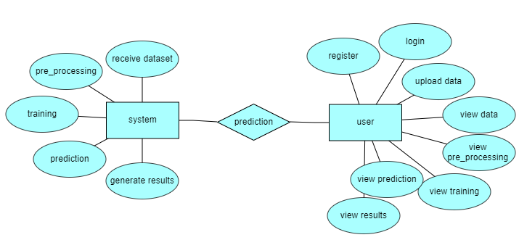

Slide 45
DFD Diagram:
A Data Flow Diagram (DFD) is a traditional way to visualize the information flows within a system. A neat and clear DFD can depict a good amount of the system requirements graphically. It can be manual, automated, or a combination of both. It shows how information enters and leaves the system, what changes the information and where information is stored. The purpose of a DFD is to show the scope and boundaries of a system as a whole. It may be used as a communications tool between a systems analyst and any person who plays a part in the system that acts as the starting point for redesigning a system.

Slide 46
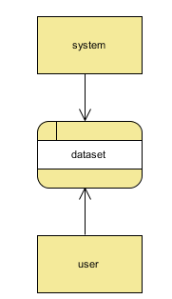
Context Level Diagram:

Slide 47
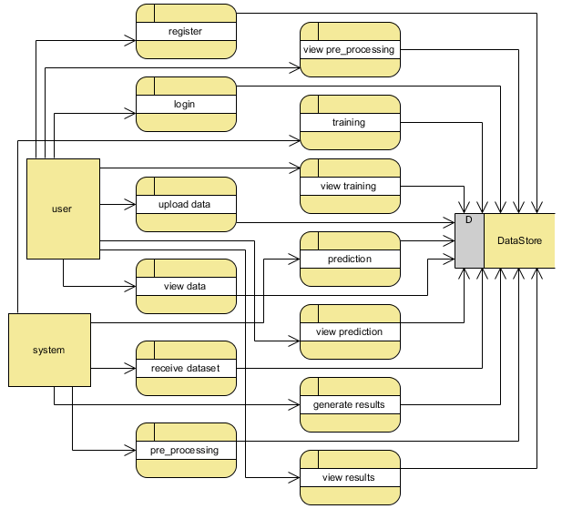
Level 1 Diagram:

Slide 48
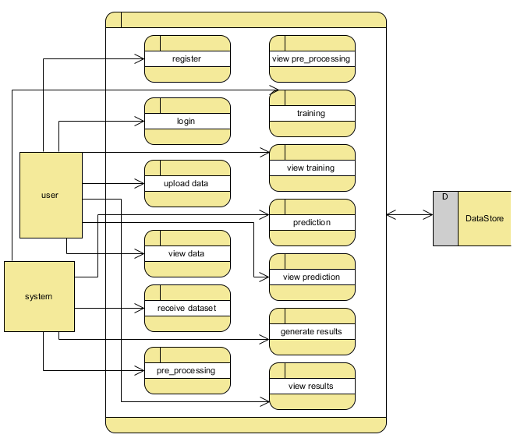
Level 2 Diagram:

